Slide 1

Distributed Systems
Unit 7 CONSISTENCY & REPLICATION
Ling ZHOU
School of Computer Science and Engineering
College of Software Engineering,
Southeast University, Nanjing
ling.zhou@seu.edu.cn

Slide 2

Unit 7 – Consistency & Replication: Outline
Introduction
Data-Centric Consistency Models
Client-Centric Consistency Models
Replica Management
Consistency Protocols
Summary

Slide 3

Introduction
Replication of data is an important issue in DS
Data are generally replicated to enhance reliability or improve performance.
One of the major problems is keeping replicas consistent.
Two points:
Reasons for Replication
Replication as Scaling Technique

Slide 4

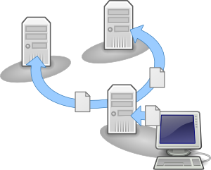
Reasons for Replication (1) -- increase the reliability of a system
A file system with replication can continue working after one replica crashes
By maintaining multiple copies, it is possible to provide better protection against corrupted data.

Slide 5
Reasons for Replication (2) -- improving performance when the DS scales
Scaling in numbers: Performance can be improved by replicating the server and subsequently dividing the work.
Placing a copy of data in the proximity of the process using them, the time to access the data decreases and the performance as perceived by that process increases.
Observation: the benefits of replication for performance may be hard to evaluate. More network bandwidth is now consumed for keeping all replicas up to date.

Slide 6
Price of Replication
Having multiple copies may lead to consistency problems.
A modified copy becomes different from the rest. → modifications have to be carried out on all copies to ensure consistency.
Exactly when and how those modifications need to be carried out determines the price of replication.
Example: improving access times to Web pages
Fetching a page from a remote Web server may sometimes even take seconds.
To improve performance, Web browsers often cache a Web page (locally store a copy)
When to update a stale copy?

Slide 7
Replication as Scaling Technique (1)
Replication and caching for performance are widely applied as scaling techniques.
A possible trade-off that needs to be made is that keeping copies up to date may require more network bandwidth
Example:
Consider a process P that accesses a local replica N times per second, whereas the replica itself is updated M times per second.
If N ≪ M, many updated versions of the local replica will never be accessed by P, rendering the network communication for those versions useless.
Solution: In this case, it may have been❶ better not to install a local replica close to P, or❷ to apply a different strategy for updating the replica.

Slide 8

Replication as Scaling Technique (2)
Observation: Keeping multiple copies consistent may itself be subject to serious scalability problems.
Intuitively, a collection of copies is consistent when the copies are always the same.
When an update operation is performed on one copy, the update should be propagated to all copies before a subsequent operation takes place
Tight consistency/synchronous replication: an update is performed at all copies as a single atomic operation, or transaction
Global synchronization simply takes a lot of communication time, especially when replicas are spread across a wide-area network.

Slide 9
Replication as Scaling Technique (3)
Dilemma:
Scalability problems can be alleviated by applying replication and caching, leading to improved performance.
To keep all copies consistent generally requires global synchronization, which is inherently costly in terms of performance.
Solution: to loosen the consistency constraints
Relax the requirement that updates need to be executed as atomic operations
The price paid is that copies may not always be the same everywhere.

Slide 10

Replication as Scaling Technique (4)
Conclusion: to what extent consistency can be loosened depends highly on the access and update patterns of the replicated data, as well as on the purpose for which those data are used.

Slide 11
Unit 7 – Consistency & Replication: Outline
Introduction
Data-Centric Consistency Models
Client-Centric Consistency Models
Replica Management
Consistency Protocols
Summary

Slide 12
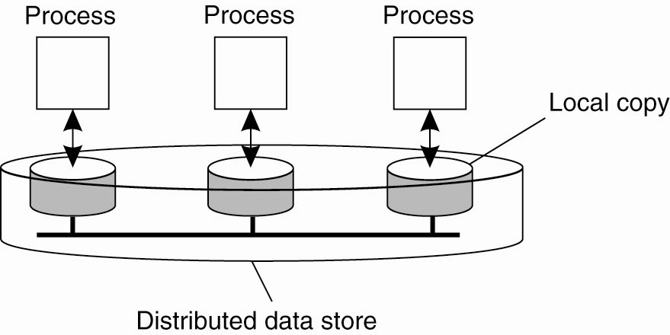
Data-Centric Consistency Models (1)
Traditionally, consistency has been discussed in the context of read and write operations on shared data (i.e., data store), available by means of (distributed) shared memory, a (distributed) shared database, or a (distributed) file system.
The general organization of a logical data store, physically distributed and replicated across multiple processes.
Each process that can access data from the store is assumed to have a local (or nearby) copy available of the entire store.

Slide 13

Data-Centric Consistency Models (2)
A Consistency Model: A contract between a (distributed) data store and processes, in which the data store specifies precisely what the results of read and write operations are in the presence of concurrency.
Normally, a process that performs a read operation on a data item, expects the operation to return a value that shows the results of the last write operation on that data.

Slide 14
Data-Centric Consistency Models (3)
In the absence of a global clock, it is difficult to define precisely which write operation is the last one.
As an alternative, we need to provide other definitions, leading to a range of consistency models.
Continuous Consistency | Consistent Ordering of Operations
The Notion of a Conit | Sequential Consistency
 | Causal Consistency
 | Grouping Operations
 | Consistency vs. Coherence

Slide 15


Continuous Consistency
Replicating data poses consistency problems that cannot be solved efficiently in a general way.
Efficient solutions: may be loosen consistency
No general rules, but highly dependent on applications.
Continuous consistency ranges: a general approach by distinguishing three independent axes for defining inconsistencies:
deviation in numerical values between replicas
deviation in staleness between replicas
deviation with respect to the ordering of update operations
Notes:
deviation 搜索网络
英 [ˌdi:viˈeɪʃn] 美 [ˌdiviˈeʃən]
CET6 | IELTS | GRE
n. 背离，偏离; 离经叛道的行为; [航]偏航; [数]绝对偏差;
变形 复数: deviations

Slide 16

Numerical Deviations
Numerical deviations can be used when data have numerical semantics or be understood in terms of the number of updates that have been applied to a given replica, but have not yet been seen by others.
Example 1: the replication of records containing stock market prices. An application may specify that two copies should not deviate more than $0.02 (absolute numerical deviation) or 0.5% (a relative numerical deviation)
Example 2: a Web cache may not have seen a batch of operations carried out by a Web server. In this case, the associated deviation in the value is also referred to as its weight.

Slide 17


Staleness Deviations
Staleness deviations relate to the last time a replica was updated. For some applications, it can be tolerated that a replica provides old data as long as it is not too old.
Example: weather reports typically stay reasonably accurate over some time, say a few hours. In such cases, a main server may receive timely updates, but may decide to propagate updates to the replicas only once in a while.

Slide 18
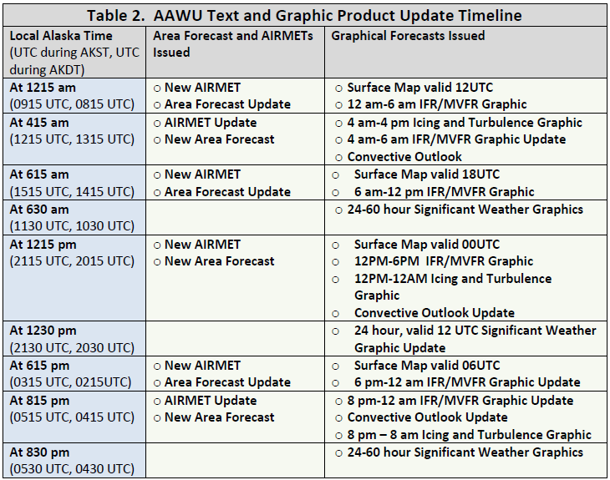
If you don’t like the weather you see at the moment, just wait for the new forecast

Slide 19
Ordering Deviations
Ordering deviations: Some classes of applications in which the ordering of updates are allowed to be different at the various replicas, as long as the differences remain bounded.
One way of looking at these updates is that they are applied tentatively to a local copy, awaiting global agreement from all replicas. As a consequence, some updates may need to be rolled back and applied in a different order before becoming permanent.
Observation: Intuitively, ordering deviations are much harder to grasp than the other two consistency metrics.

Slide 20
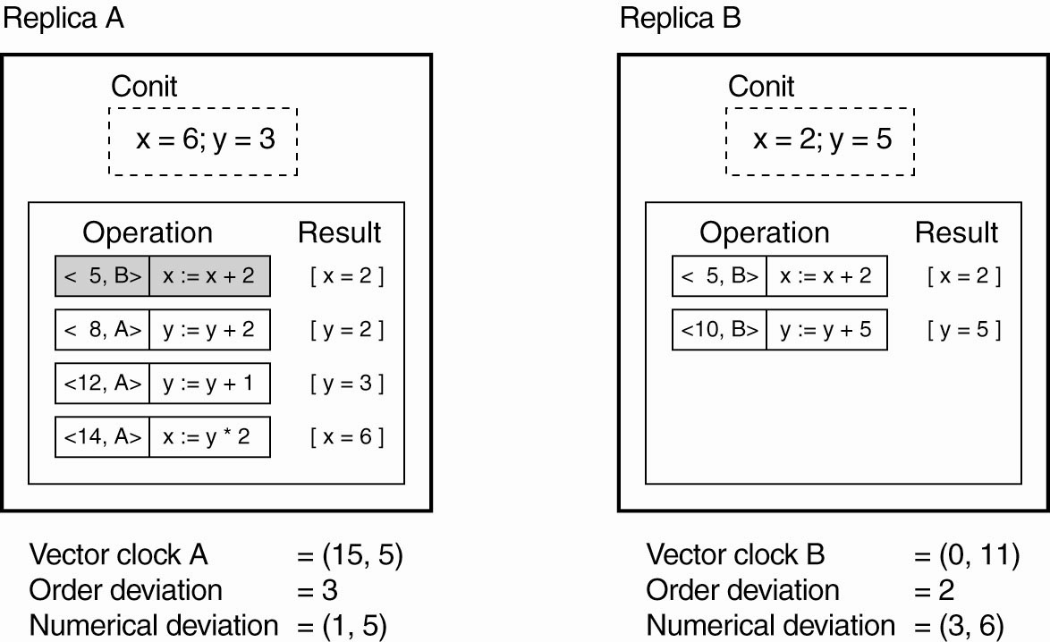
The Notion of a Conit
Conit (a consistency unit): to define inconsistencies, e.g., a conit could be defined as a record representing a single stock or an individual weather report
Permanent operation from B has been committed at A and cannot be rolled back
Notation (t, i) expresses an operation that was carried out by replica i at (its) logical time t
(t, i)
Assumption:
Initially x=0, y=0
A has missed one operation from B, yielding a max diff of 5 units →(1,5)
Two-dimensional VC
Tentative local updates
With respect to operations
An example of keeping track of consistency deviations (numerical and ordering)
Two replicas operating on a conit containing the data items x and y
Total weight
Notes:
In this example, the weight of this deviation can be expressed as the maximum difference between the (committed)
values of x and y at A, and the result from operations at B not seen by A. The
committed value at A is (x,y) = (2,0), whereas the-for A unseen-operation at B
yields a difference of y = 5.
A similar reasoning shows that B has two tentative update operations: 5,B
and 10,B , which means it has an ordering deviation of 2. Because B has not yet
seen a single operation from A, its vector clock becomes (0, 11). The numerical
deviation is 3 with a total weight of 6. This last value comes from the fact B's
committed value is (x,y) = (0,0), whereas the tentative operations at A will
already bring x to 6.

Slide 21
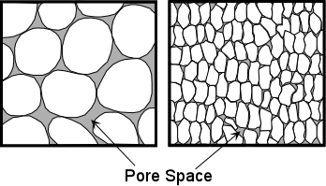
Fine-Grained and Coarse-Grained Conits
A coarse grained conit: represents a lot of data, e.g., a complete database
Updates are aggregated for all the data in the conit
Replicas will be sooner in an inconsistent state.
A smaller conit: the data items contained in a conit are used completely independently (falsely share the conit)

Slide 22
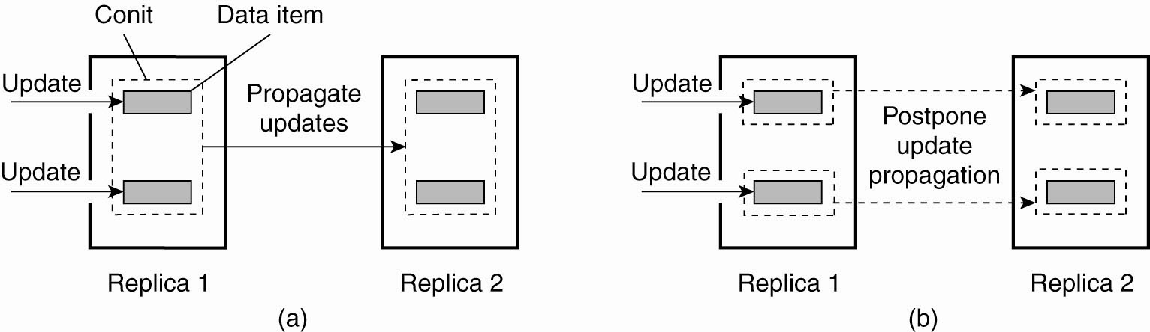
Choosing The Appropriate Granularity For A Conit
Assumption: two replicas may differ in no more than one outstanding update.
Two updates lead to update propagation.
No update propagation is needed (yet).
The replicas are still considered to be up to date.
Notes:
Fig. 7-3 two replicas may differ in no more than one outstanding (Still in existence; not settled or resolved:
未完成的：仍然存在的；未决定或未解决的：) update. In that
case, when the data items in Fig. 7-3(a) have each been updated once at the first
replica, the second one will need to be updated as well. This is not the case when
choosing a smaller conit, as shown in Fig. 7-3(b). There, the replicas are still considered
to be up to date. This problem is particularly important when the data
items contained in a conit are used completely independently, in which case they
are said to falsely share the conit.

Slide 23


Problems About Conit
There is a trade-off between maintaining fine-grained and coarse-grained conits.
Making conits very small is not a good idea,
The total number of conits that need to be managed grows as well. There is an overhead related to management.
This overhead may adversely affect overall performance.

Slide 24
Two Important Issues For Conits’ Practical Use
Protocols are needed in order to enforce consistency
Consistency requirements have to be specified (which may be very difficult) by program developers for their applications
It is mandatory that there are simple and easy-to-understand programming interfaces.
E.g., continuous consistency can be implemented as a toolkit which appears to programmers as just another library that they link with their applications.
Notes:
Although conceptually conits form an attractive means for capturing consistency requirements, there are still two important issues for the practical use.

Slide 25
Conit: Example
A conit is simply declared alongside an update of a data item.
AffectConit(ConitQ, 1, 1);
Append message m to queue Q;
Operations may also be declared as being dependent on conits:
DependsOnConit(ConitQ, 4, 0, 60);
Read message m from head of queue Q
states that appending a message to queue Q belongs to a conit named “ConitQ”
at most 4 unseen update operations at other replicas
no tentative local updates
Staleness of local copy of Q is no more than 60 seconds ago
The call to DependsOnConit( ) specifies that the numerical deviation, ordering deviation, and staleness should be limited to the values 4, 0, and 60 (seconds), respectively.

Slide 26
Data-Centric Consistency Models (3)
In the absence of a global clock, it is difficult to define precisely which write operation is the last one.
As an alternative, we need to provide other definitions, leading to a range of consistency models.
Continuous Consistency | Consistent Ordering of Operations
The Notion of a Conit | Sequential Consistency
 | Causal Consistency
 | Grouping Operations
 | Consistency vs. Coherence

Slide 27
Consistent Ordering of Operations
In parallel and distributed computing, multiple processes will need to share resources and access these resources simultaneously → the semantics of concurrent accesses need to be expressed when shared resources are replicated (concurrent programming)
Models dealing with consistently ordering operations on shared, replicated data (the essence is to agree on a global consistent ordering of tentative updates at replicas.)
Sequential Consistency
Causal Consistency (weaker model)
Grouping Operations
Consistency vs. Coherence

Slide 28
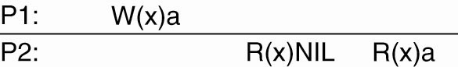
Sequential Consistency (1)
A special notation in which we draw the operations of a process along a time axis.
W_{i}(x)a : a write by process P_{i} to data item x with the value a
R_{i}(x)b : a read from that item by P_{i} returning b
Assumption: each data item is initially NIL.
NOTE: When there is no confusion concerning which process is accessing data, we omit the index from the symbols W and R.
It took some time to propagate the update of x to P2
t

Slide 29

Who is Lamport?
Leslie Lamport
Education
B.S. -- M.I.T., 1960. (Mathematics)
M.A. -- Brandeis University, 1963. (Mathematics)
Ph.D. -- Brandeis University, 1972. (Mathematics)
Employment
Mitre Corporation (part-time, 1962-1965)
Marlboro College (1965-1969)
Massachusetts Computer Associates (1970-1977)
SRI International (1977-1985)
Digital Equipment Corporation / Compaq (1985-2001)
Microsoft Research (2001-present)

Slide 30
Sequential Consistency (2)
Sequential consistency is an important data-centric consistency model [first defined by Lamport (1979) in the context of shared memory for multiprocessor systems.] In general, a data store is said to be sequentially consistent when it satisfies the following condition:
Definition: The result of any execution is the same as if the operations of all processes were executed in some sequential order, and the operations of each individual process appear in this sequence in the order specified by its program.
Meaning of definition: when processes run concurrently on (possibly) different machines, any valid interleaving of read and write operations is acceptable behavior, but all processes see the same interleaving of operations.
NOTE: Note that nothing is said about time; that is, there is no reference to the “most recent” write operation on a data item. in this context, a process “sees” writes from all processes but only its own reads.

Slide 31
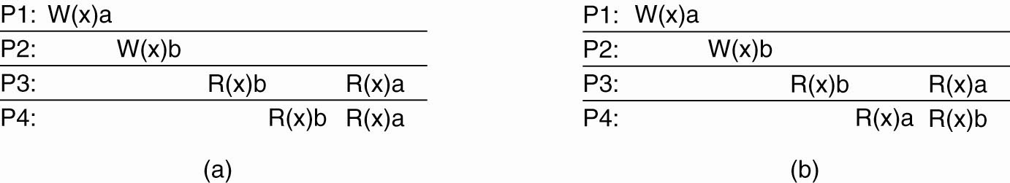
Sequentially Consistent Data Store Example (1)
A sequentially consistent data store.
both processes P3 and P4 first read value b, and later value a. In other words, the write operation of process P2 appears to have taken place before that of P1·
A data store that is NOT sequentially consistent.
Not all processes see the same interleaving of write operations.

Slide 32
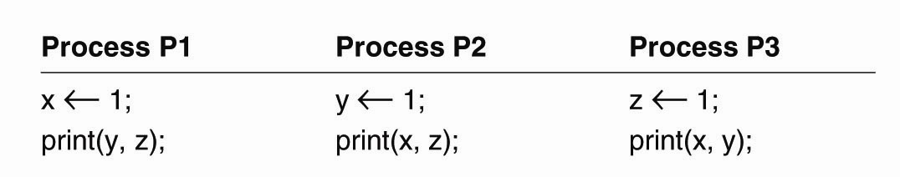
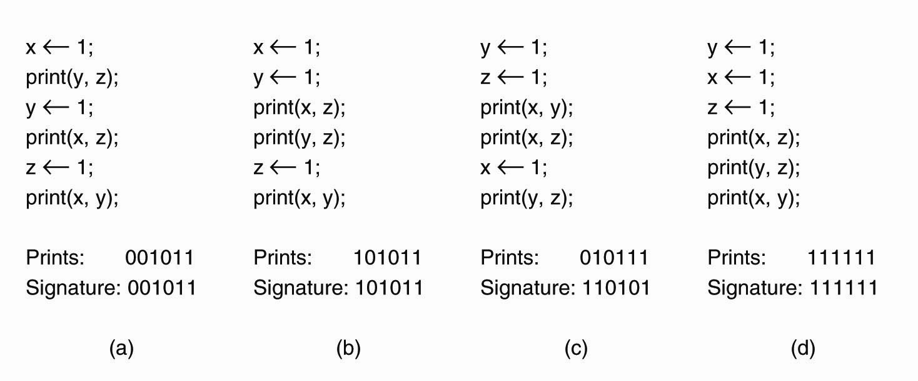
Sequentially Consistent Data Store Example (2)
Three concurrently executing processes.
Assumption: initially x, y, z= 0.
Various interleaved execution sequences are possible.
write operation
t
read operation
Four valid execution sequences
Only a total of 90 out of 6! = 720 possible execution sequences are valid.
P1
P2
P3
P2
P1
P2
P2
P1
P3
P3
P1
P3
P1
P2
P3
P2
P1
P3
P3
P2
P1
P2
P1
P3
t
P1
P2
P3
P1
P2
P3
P1
P2
P3
P1
P2
P3
Signature: concatenates the output of P1, P2, and P3 in that order. A 6-bit string characterizes a particular interleaving of statements. Not all 2⁶ = 64 signature patterns are allowed.
Conclusions: The 90 different valid statement orderings produce a variety of different program results (< 64) that are allowed under the assumption of sequential consistency.
Notes:
6! = 6 factorial
With six independent statements, there are potentially 720 (6!) possible execution sequences, although
some of these violate program order.
Not all 64 signature patterns are allowed. As a trivial example, 000000 is not
permitted, because that would imply that the print statements ran before the
assignment statements, violating the requirement that statements are executed in
program order. A more subtle example is 001001 (not allowed).

Slide 33
Causal Consistency
The causal consistency model (Hutto and Ahamad, 1990) represents a weakening of sequential consistency in that it makes a distinction between events that are potentially causally related and those that are not.
Concurrent writes: if two processes spontaneously and simultaneously write two different data items, these are not causally related. Operations that are not causally related are said to be concurrent.
For a data store to be considered causally consistent, it is necessary that the store obeys the following condition:
Writes that are potentially causally related must be seen by all processes in the same order. Concurrent writes may be seen in a different order on different machines.

Slide 34
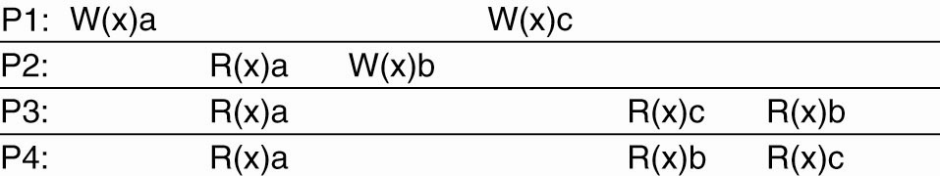
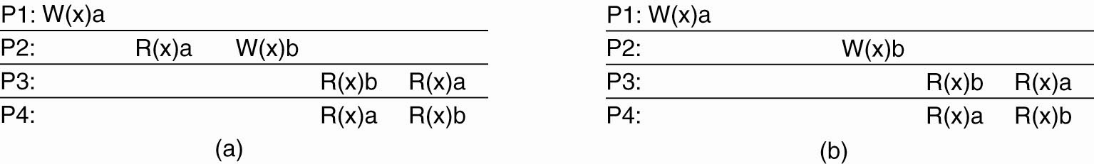
Causal Consistency: Examples
Causally related
Concurrent
This sequence is allowed with a causally-consistent store, but not with a sequentially consistent store
Concurrent
Causally related
A violation of a causally-consistent store
A correct sequence of events in a causally-consistent store
(but NOT acceptable for a sequentially consistent store)

Slide 35
Grouping Operations (1)
Sequential and causal consistency are defined at the level read and write operations.
Historical reasons: these models have initially been developed for shared-memory multiprocessor systems and were actually implemented at the hardware level.
The fine granularity of these consistency models in many cases did not match the granularity as provided by applications.
At the program level read and write operations are bracketed by the pair of operations ENTER_CS and LEAVE_CS where "CS" stands for critical section.
Critical Section: code that accesses a critical resource
Critical Resource: a resource shared with constraints on its use (e.g., memory, files, printers, etc.)

Slide 36

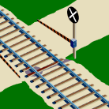
Grouping Operations (2)
Concurrency between programs sharing data is generally kept under control through synchronization mechanisms for mutual exclusion and transactions.
Mutual Exclusion: at most one process may be executing a Critical Section with respect to a particular critical resource simultaneously
Synchronization between processes
A process that has successfully executed ENTER_CS will be ensured that the data in its local store is up to date.
At that point, it can safely execute a series of read and write operations on that store, and subsequently wrap things up by calling LEAVE_CS.

Slide 37
Grouping Operations (3)
Within a program the data that are operated on by a series of read and write operations are protected against concurrent accesses
Executing the series as a whole: the bracketing turns the series of read and write operations into an atomically executed unit → raising the level of granularity
The semantics concerning the operations ENTER_CS and LEAVE_CS can be formulated in terms of shared synchronization variables (which can be used in different ways)
A convention: when a process enters its CS it should acquire the relevant synchronization variables, and likewise when it leaves the CS, it releases these variables.

Slide 38
Grouping Operations (4)
The general approach of using shared synchronization variables
each variable has some associated data, which could amount to the complete set of shared data.
Each synchronization variable has a current owner, namely, the process that last acquired it.
The owner may enter and exit critical sections repeatedly without having to send any messages on the network.
A process (not owner) wants to acquire the variables has to send a message to the owner asking for ownership and the current values.
Several processes can simultaneously own a synchronization variable in nonexclusive mode, meaning that they can read, but not write, the associated data.

Slide 39
Grouping Operations (5)
Definition
Accesses to synchronization variables are sequentially consistent.
No access to a synchronization variable is allowed to be performed until all previous writes have completed everywhere.
No data access is allowed to be performed until all previous accesses to synchronization variables have been performed.
Basic idea
You don’t care that reads and writes of a series of operations are immediately known to other processes. You just want the effect of the series itself to be known.

Slide 40
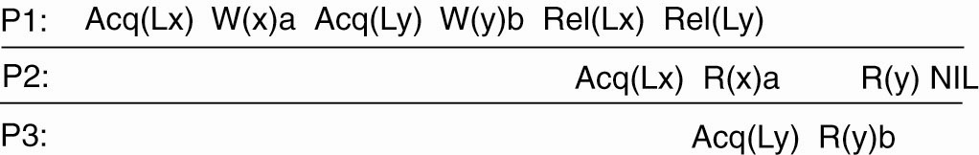
Grouping Operations (6)
P2: No Acq(Ly)
A valid event sequence for entry consistency
Instead of operating on the entire shared data, in this example we associate locks with each data item.
One straightforward approach of associating data with synchronization variables: to explicitly tell the middleware which data are going to be accessed.
In an object-based approach, we could implicitly associate a unique synchronization variable with each declared object, effectively serializing all invocations to such objects.

Slide 41
Consistency vs. Coherence
A consistency model describes what can be expected with respect to that set when multiple processes concurrently operate on that data. The set is said to be consistent if it adheres to the rules described by the model.
Data consistency is concerned with a set of data items
Coherence models describe what can be expected to only a single data item
We assume that a data item is replicated at several places; it is said to be coherent when the various copies abide to the rules as defined by its associated coherence model.
Example: Sequential consistency applied to only a single data item.
Notes:
A popular model is that of sequential consistency, but
now applied to only a single data item. In effect, it means that in the case of
concurrent writes, all processes will eventually see the same order of updates taking
place.

Slide 42


Slide 43
Unit 7 – Consistency & Replication: Outline
Introduction
Data-Centric Consistency Models
Client-Centric Consistency Models
Replica Management
Consistency Protocols
Summary

Slide 44
Client-Centric Consistency Models (1)
Review
The consistency models described previously aim at providing a system-wide consistent view on a data store.
Being able to handle concurrent operations on shared data while maintaining sequential consistency is fundamental to DS.
For performance reasons, sequential consistency may possibly be guaranteed only when processes use synchronization mechanisms such as transactions or locks.

Slide 45
Client-Centric Consistency Models (2)
Overview
System model (eventual consistency is a very weak consistency model)
Monotonic reads
Monotonic writes
Read-your-writes
Write-follows-reads
Goal
Show how we can perhaps avoid system-wide consistency, by concentrating on what specific clients want, instead of what should be maintained by servers.
Four different consistency models

Slide 46
Eventual Consistency (1)
Observation: To what extent processes actually operate in a concurrent fashion, and to what extent consistency needs to be guaranteed, may vary.
Concurrency often appears only in a restricted form.
Example 1:
In many database systems, most processes hardly ever perform update operations; they mostly read data from the database. Only one, or very few processes perform update operations.
Question: How fast updates should be made available to only-reading processes?
Notes:
As another example, consider a worldwide naming system such as DNS. The
DNS name space is partitioned into domains, where each domain is assigned to a
naming authority, which acts as owner of that domain. Only that authority is allowed
to update its part of the name space. Consequently, conflicts resulting from
two operations that both want to perform an update on the same data (i.e., writewrite
conflicts), never occur. The only situation that needs to be handled are
read-write conflicts, in which one process wants to update a data item while another
is concurrently attempting to read that item.
As it turns out, it is often
acceptable to propagate an update in a lazy fashion, meaning that a reading process
will see an update only after some time has passed since the update took place.
Yet another example is the World Wide Web. In virtually all cases, Web
pages are updated by a single authority, such as a webmaster or the actual owner
of the page. There are normally no write-write conflicts to resolve. On the other
hand, to improve efficiency, browsers and Web proxies are often configured to
keep a fetched page in a local cache and to return that page upon the next request.

Slide 47
Eventual Consistency (2)
Observation: To what extent processes actually operate in a concurrent fashion, and to what extent consistency needs to be guaranteed, may vary.
Concurrency often appears only in a restricted form.
Example 2:
Each domain of DNS is assigned to a naming authority, which is allowed to update its part of the name space. →No write-write conflicts (concurrent updates on the same data); only read-write conflicts need to be handled
Solution: It is often acceptable to propagate an update in a lazy fashion, meaning that a reading process will see an update only after some time has passed since the update took place
Notes:
As another example, consider a worldwide naming system such as DNS. The
DNS name space is partitioned into domains, where each domain is assigned to a
naming authority, which acts as owner of that domain. Only that authority is allowed
to update its part of the name space. Consequently, conflicts resulting from
two operations that both want to perform an update on the same data (i.e., writewrite
conflicts), never occur. The only situation that needs to be handled are
read-write conflicts, in which one process wants to update a data item while another
is concurrently attempting to read that item.
As it turns out, it is often
acceptable to propagate an update in a lazy fashion, meaning that a reading process
will see an update only after some time has passed since the update took place.
Yet another example is the World Wide Web. In virtually all cases, Web
pages are updated by a single authority, such as a webmaster or the actual owner
of the page. There are normally no write-write conflicts to resolve. On the other
hand, to improve efficiency, browsers and Web proxies are often configured to
keep a fetched page in a local cache and to return that page upon the next request.

Slide 48
Eventual Consistency (3)
Observation: To what extent processes actually operate in a concurrent fashion, and to what extent consistency needs to be guaranteed, may vary.
Concurrency often appears only in a restricted form.
Example 3:
Web pages are updated by a single authority (e.g. webmaster/owner).
No write-write conflicts to resolve.
To improve efficiency, browsers and Web proxies cache pages and return updated page upon the next request. In fact, many users find this inconsistency acceptable to a certain degree.
Notes:
As another example, consider a worldwide naming system such as DNS. The
DNS name space is partitioned into domains, where each domain is assigned to a
naming authority, which acts as owner of that domain. Only that authority is allowed
to update its part of the name space. Consequently, conflicts resulting from
two operations that both want to perform an update on the same data (i.e., writewrite
conflicts), never occur. The only situation that needs to be handled are
read-write conflicts, in which one process wants to update a data item while another
is concurrently attempting to read that item.
As it turns out, it is often
acceptable to propagate an update in a lazy fashion, meaning that a reading process
will see an update only after some time has passed since the update took place.
Yet another example is the World Wide Web. In virtually all cases, Web
pages are updated by a single authority, such as a webmaster or the actual owner
of the page. There are normally no write-write conflicts to resolve. On the other
hand, to improve efficiency, browsers and Web proxies are often configured to
keep a fetched page in a local cache and to return that page upon the next request.

Slide 49
Eventual Consistency (4)
These listed examples can be viewed as cases of (large-scale) distributed and replicated databases that tolerate a relatively high degree of inconsistency.
They have in common that if no updates take place for a long time, all replicas will gradually become consistent. (so-called eventual consistency)
essentially requires only that updates are guaranteed to propagate to all replicas.
write-write conflicts are often relatively easy to solve when assuming that only a small group of processes can perform updates.
eventual consistency is often cheap to implement.

Slide 50
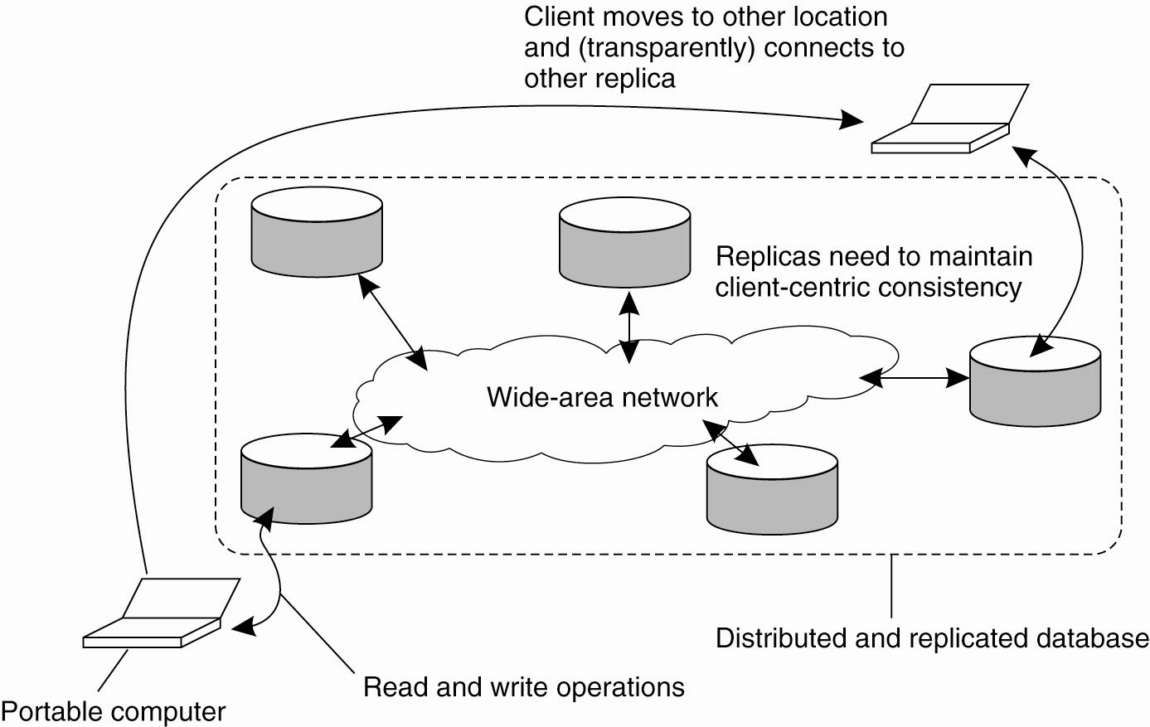
Eventual Consistency: Consistency for Mobile Users
Eventual consistent data stores work fine as long as clients always access the same replica.
Problems arise when different replicas are accessed over a short period of time.
Transparent connection: the application running on the portable computer is unaware on which replica it is actually operating.
If the updates have not yet been propagated, the user will notice inconsistent behavior.
No propagation of updates yet
Notes:
Stop here 20120523

Slide 51
Solution to Consistency Problem for Mobile Users
client-centric consistency provides guarantees for a single client concerning the consistency of accesses to a data store by that client. No guarantees are given concerning concurrent accesses by different clients.
Client-centric consistency models originate from the work on Bayou.
Bayou is a database system developed for mobile computing
It is assumed that network connectivity is unreliable and subject to various performance problems.
Wireless networks and networks that span large areas, such as the Internet, fall into this category.
Bayou essentially distinguishes four different consistency models.

Slide 52

Client-centric consistency models Description
When a process accesses a physically distributed data store, it generally connects to the locally (or nearest) available copy. All read and write operations are performed on that local copy. Updates are eventually propagated to the other copies.
Assumption: data items have an associated owner, which is the only process that is permitted to modify that item → avoid write-write conflicts

Slide 53

Client-centric consistency models Notation
WS(x_{i}[t]) : denotes the set of write operations at local copy L_{i} that lead to version x_{i} of x (at time t)
WS(x_{i}[t1]; x_{j}[t2]) : indicates that it is known that WS(x_{i}[t1]) is part of WS(x_{j}[t2]) . i.e., if operations in WS(x_{i}[t1]) have also been performed at local copy L_{j} at a later time t2
If the ordering of operations or the timing is clear from the context, the time index will be omitted.

Slide 54
Monotonic Reads (1)
A data store is said to provide monotonic-read consistency if the following condition holds:
If a process reads the value of a data item x, any successive read operation on x by that process will always return that same value or a more recent value.
In other words, monotonic-read consistency guarantees that if a process has seen a value of x at time t, it will never see an older version of x at a later time.

Slide 55
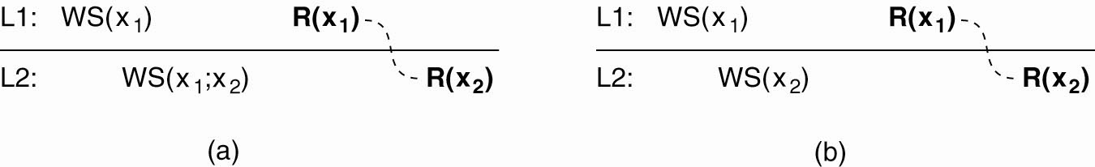
Monotonic Reads (2)
The read operations performed by a single process P at two different local copies of the same data store.
These specific operations are shown in boldface are connected by a dashed line representing the order in which they are carried out by P.
t
t
To guarantee monotonic-read consistency, all operations in WS(x₁) should have been propagated to L2 before the second read operation takes place.
Only the write operations in WS(x₂) have been performed at L2. No guarantees are given that this set also contains all operations contained in WS (x₁)

Slide 56
Monotonic Reads (3)
Example 1: Automatically reading your personal calendar updates from different servers. Monotonic Reads guarantees that the user sees all updates, no matter from which server the automatic reading takes place.
Example 2 (distributed email database): Reading (not modifying) incoming mail while you are on the move. Each time you connect to a different e-mail server, that server fetches (at least) all the updates from the server you previously visited.
Updates are propagated in a lazy (i.e., on demand) fashion.

Slide 57
Monotonic Writes (1)
In a monotonic-write consistent store, the following condition holds:
A write operation by a process on a data item x is completed before any successive write operation on x by the same process.
In other words, a write operation on a copy of item x is performed only if that copy has been brought up to date by means of any preceding write operation, which may have taken place on other copies of x. If need be, the new write must wait for old ones to finish.

Slide 58

Monotonic Writes (2)
NOTE:
Monotonic-write consistency resembles data-centric FIFO consistency (write operations by the same process are performed in the correct order everywhere).
This ordering constraint also applies to monotonic writes, except that we are now considering consistency only for a single process instead of for a collection of concurrent processes.

Slide 59
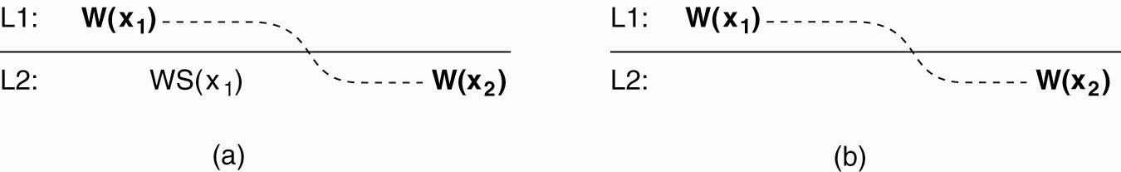
Monotonic Writes (3)
The write operations performed by a single process P at two different local copies of the same data store.
A monotonic-write consistent data store
A data store that does not provide monotonic-write consistency
NOTE:
Strict definition: write operations by the same process are performed in the same order as they are initiated.
A somewhat weaker form: the effects of a write operation are seen only if all preceding writes have been carried out as well, but perhaps not in the initial order, when write operations are commutative and ordering is really not necessary.
Notes:
commutative 搜索网络
英 [kəˈmju:tətɪv] 美 [ˈkɑmjəˌtetɪv, kəˈmjutətɪv]
adj. 交换的，代替的;

Slide 60
Monotonic Writes (4)
Example 1: Updating a program at server S2, and ensuring that all components on which compilation and linking depends, are also placed at S2.
A software library.
In many cases, updating such a library is done by replacing one or more functions, leading to a next version.
With monotonic-write consistency, guarantees are given that if an update is performed on a copy of the library, all preceding updates will be performed first.
The resulting library will then indeed become the most recent version and will include all updates that have led to previous versions of the library.
Example 2:
Maintaining versions of replicated files in the correct order everywhere (propagate the previous version to the server where the newest version is installed).

Slide 61


Read Your Writes (1)
Definition (closely related to monotonic reads):
The effect of a write operation by a process on data item x, will always be seen by a successive read operation on x by the same process.
In other words, a write operation is always completed before a successive read operation by the same process, no matter where that read operation takes place.

Slide 62
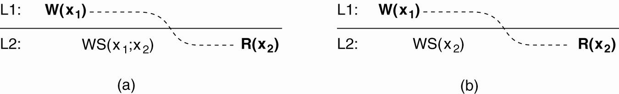
Read Your Writes (2)
Read-your-writes consistency guarantees that the effects of the write operation can be seen by the succeeding read operation. This is expressed by WS(x₁; x₂), which states that W(x₁) is part of WS(x₂)
A data store that provides read-your-writes consistency
A data store that does not.
W(x₁) has been left out of WS(x₂), meaning that the effects of the previous write operation by process P have not been propagated to L2·

Slide 63

Read Your Writes (3)
Example 1: Updating your Web page and guaranteeing that your Web browser shows the newest version instead of its cached copy.
Example 2: Updating passwords.
For example, to enter a digital library on the Web, via an account with an accompanying password.
Changing a password may take some time to come into effect.
The delay can be caused because a separate server is used to manage passwords and it may take some time to subsequently propagate (encrypted) passwords to the various servers that constitute the library.

Slide 64

Writes Follow Reads
Definition: A write operation by a process on a data item x following a previous read operation on x by the same process, is guaranteed to take place on the same or a more recent value of x that was read.
In other words, any successive write operation by a process on a data item x will be performed on a copy of x that is up to date with the value most recently read by that process.
Example: Writes-follow-reads consistency can be used to guarantee that users of a network newsgroup see a posting of a reaction to an article only after they have seen the original article

Slide 65
Topics for Seminar 6
Douglas B. Terry, et. al., “The Case for Non-transparent Replication: Examples from Bayou”, IEEE Data Engineering, (21)4:12-20, Dec. 1998.
Douglas B. Terry, et. al., “Session Guarantees for Weakly Consistent Replicated Data.” Proc. Third Int’l Conf. on Parallel and Distributed Information Systems, (Austin, TX). Los Alamitos, CA: IEEE Computer Society Press, 1994. pp. 140-149.
Werner Vogels, Eventually Consistent, Communications of the ACM, January 2009, 52(1): 40-44.
Hadoop Distributed File System
Yuqing Zhua, Jianmin Wang, “Client-centric consistency formalization and verification for system with large-scale distributed data storage”, Future Generation Computer Systems 26 (2010) pages: 1180-1188
“Balancing Strong and Eventual Consistency with Google Cloud Datastore”, Google cloud platform
Tim Kraska Martin Hentschel, “Consistency Rationing in the Cloud: Pay only when it matters”, Proceedings of the VLDB Endowment VLDB Endowment Hompage archive , Volume 2 Issue 1, August 2009, Pages 253-264

Slide 66
Unit 7 – Consistency & Replication: Outline
Introduction
Data-Centric Consistency Models
Client-Centric Consistency Models
Replica Management
Consistency Protocols
Summary

Slide 67
Replica Management
A key issue for DS that supports replication is to decide where, when, and by whom replicas should be placed, and subsequently which mechanisms to use for keeping the replicas consistent.
Two sub-problems:
replica servers placement
content placement
concerned with finding the best locations to place a server that can host (part of) a data store.
deals with finding the best servers for placing content, NOTE: often means searching the optimal placement of only a single data item
Obviously, before content placement can take place, replica servers will have to be placed first.

Slide 68

Replica-Server Placement (1)
Replica-Server Placement is NOT an intensively studied problem
often more of a management and commercial issue than an optimization problem.
Nonetheless, analysis of client and network properties are useful to come to informed decisions.
Essence: Figure out what the best K places are out of N possible locations (K < N) (an optimization problem).

Slide 69
Replica-Server Placement (2)
Various ways to compute the best placement:
Select best location out of N - K for which the average distance to clients is minimal, given that K servers have been placed. Then choose the next best server. (Note: The first chosen location minimizes the average distance to all clients.) Computationally expensive.
Select the K-th largest autonomous system and place a server at the best-connected host. Computationally expensive.
Position nodes in a d-dimensional geometric space, where distance reflects latency. Identify the K regions with highest density and place a server in every one. Computationally cheap. (Done in real-time)

Slide 70
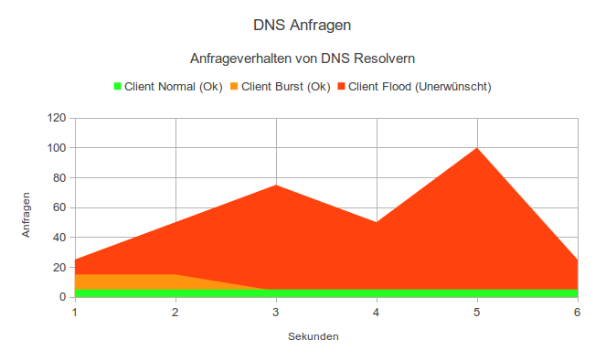
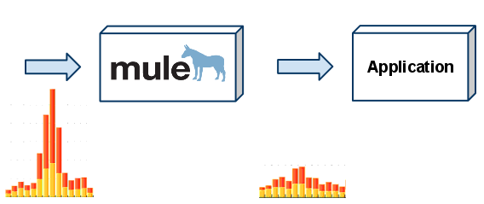
Replica-Server Placement (3)
Computationally-complex problems can be solved only through heuristics.
for even a few thousand locations, a computation may need to run for tens of minutes.
Long computational time may be unacceptable, notably when there are flash crowds (a sudden burst of requests for one specific site, which occur regularly on the Internet).
In that case, quickly determining where replica servers are needed is essential, after which a specific one can be selected for content placement.
Notes:
using Mule ESB as a frontal load-throttling middleware for applications that are not able to handle sudden peaks of requests, as illustrated in the following diagram.

Slide 71
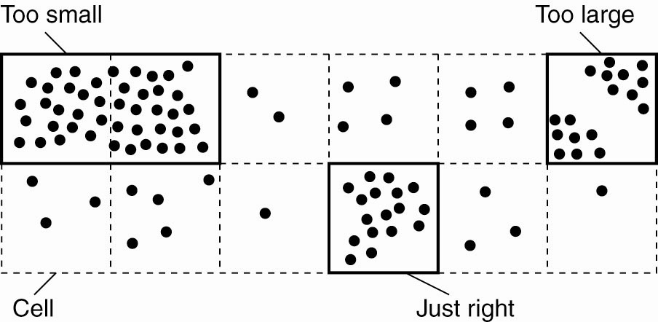
Replica-Server Placement (4)
To identify these clusters, the entire space is partitioned into cells. The cell size is important.
Too large: multiple clusters of nodes may be contained in the same cell. → too few replica servers
Too small: a single cluster is spread across a number of cells → too many replica servers

Slide 72


Content Replication and Placement
Distinguish different processes
A process is capable of hosting a replica of an object or data:
Permanent replicas: Process/machine always having a replica
Server-initiated replica: Process that can dynamically host a replica on request of another server in the data store
Client-initiated replica: Process that can dynamically host a replica on request of a client (client cache)

Slide 73
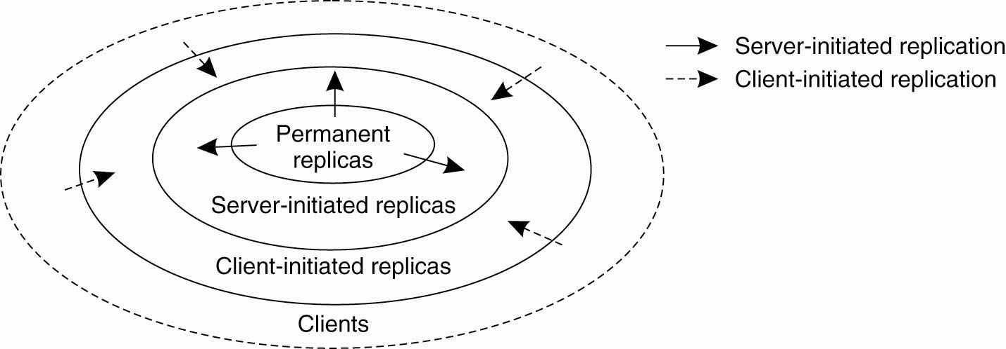
Relationship Among Different Kinds of Replicas
The logical organization of different kinds of copies of a data store into three concentric rings

Slide 74
Permanent Replicas
Description:
the initial set of replicas that constitute a distributed data store.
the number of permanent replicas is small.
Example: two forms of distributing a Web site
the files are replicated across a limited number of servers at a single location.
Whenever a request comes in, it is forwarded to one of the servers, e.g., using a round-robin strategy.
Mirroring: a Web site is copied to a limited number of servers (mirror sites), which are geographically spread across the Internet.

Slide 75

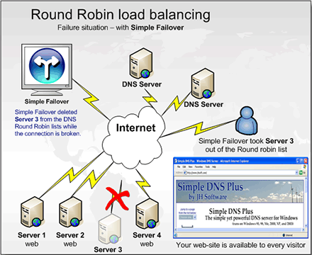
Permanent Replicas -- Replicated files
the files are replicated across a limited number of servers at a single location.
Whenever a request comes in, it is forwarded to one of the servers, e.g., using a round-robin strategy.

Slide 76
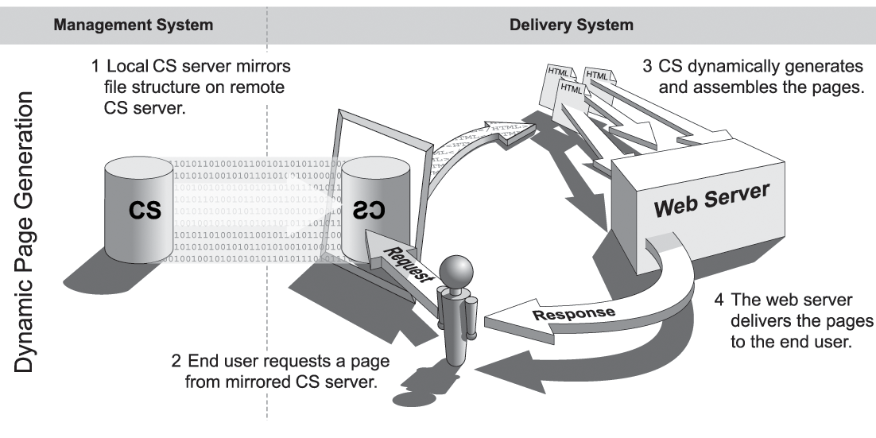
Permanent Replicas -- Mirroring

Slide 77
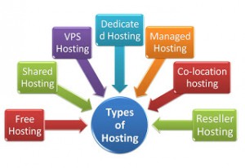

Server-Initiated Replicas (1)
Description: copies of a data store that exist to enhance performance
Dynamical replica placement:
the (Web) server install some temporary replicas in regions where many requests are coming from.
Web hosting services: offer a (relatively static) collection of servers spread across the Internet that can maintain and provide access to Web files belonging to third parties

Slide 78
Server-Initiated Replicas (2)
Observation: Given that the replica servers are already in place, deciding where to place content is easier than in the case of server placement
Dynamic replication algorithm (to support Web pages)
Assumption: # updates << # read requests; using files as the unit of data
Two issues:
Replication can take place to reduce the load on a server.
Specific files on a server can be migrated or replicated to servers placed in the proximity of clients

Slide 79
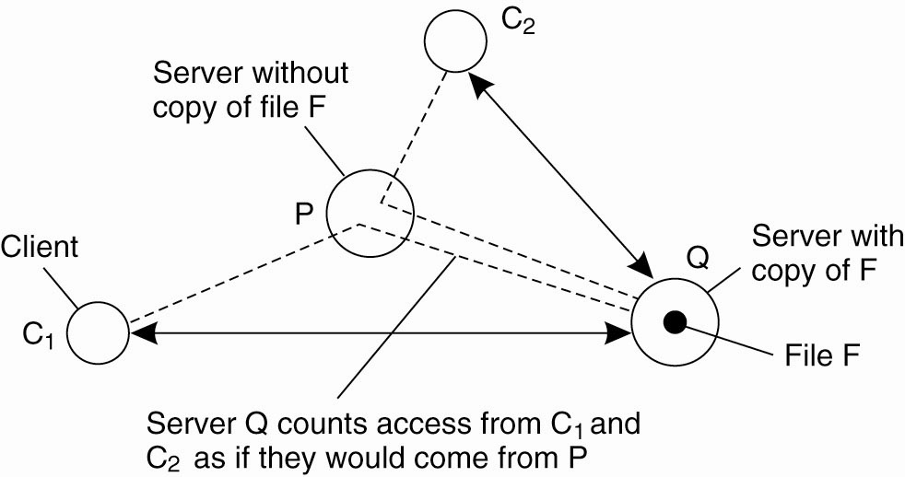
Server-Initiated Replicas (3)
Number of accesses: cnt_{Q}(P, F)
Deletion threshold: del(Q, F)
Replication threshold: rep(Q, F)
del(Q, F) < rep(Q, F)
Special measures are taken to ensure that at least one copy of each file continues to exist
Keep track of access counts per file F, cnt_{Q}(P, F), aggregated by considering server P closest to requesting clients
cnt_{Q}(P, F) < del(Q, F) → remove F (unless F is the last copy)
cnt_{Q}(P, F) > rep(Q,F) → replicate F
del(Q, F) < cnt_{Q}(P, F) < rep(Q,F) → migrate F to P (If P is heavily loaded, Q will attempt to migrate F on other servers)

Slide 80
Client-Initiated Replicas (1)
Client-initiated replicas, a.k.a. (client) caches
a cache is a local storage facility that is used by a client to temporarily store a copy of the data it has just requested.
Managing the cache is left entirely to the client.
The data store from where the data had been fetched has nothing to do with keeping cached data consistent.
Storage time: a limited amount of time (hours/days)
The client can rely on participation from the data store to inform it when cached data has become stale.

Slide 81
Client-Initiated Replicas (2)
Function: Client caches are used to improve access times to data.
Placement: a cache is normally placed on the client's machine, or on a separate machine shared by clients on the same LAN.
In some cases, extra levels of caching are introduced by placing a shared cache in a WAN and let a client locate the nearest server.
A cache hit: requested data can be fetched from the local cache
Notes:
When a program accesses a memory location that is not in the cache, it is called a cache miss.

Slide 82
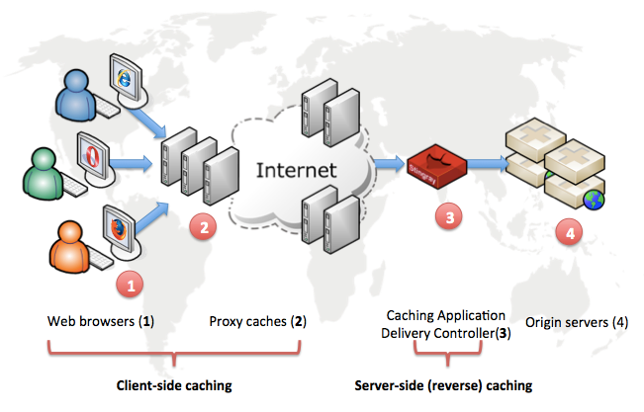
Client-Initiated Replicas (3)
Goal: save money on bandwidth
improve access times
Goal: accelerate your website

Slide 83
Functions of Different Kinds of Replicas
Permanent replicas are still often useful as a back-up facility, or to be used as the only replicas that are allowed to be changed to guarantee consistency.
Server-initiated replicas are used for placing read-only copies close to clients and for balancing loads among servers.
Client caches are used to improve access times to data and are managed by clients.

Slide 84

Content Distribution
Replica management also deals with propagation of (updated) content to the relevant replica servers
State vs. Operations
Pull vs. Push Protocols
Unicasting vs. Multicasting

Slide 85
State vs. Operations
What is actually to be propagated in order to save bandwidth / communication overhead
?
Basically, there are three possibilities:
Propagate only a notification of an update (often used for caches)
when the read-to-write ratio is relatively small
invalidation protocols: the only information that needs to be transferred is a specification of which data are no longer valid
Transfer modified data from one copy to another (distributed databases)
when the read-to-write ratio is relatively high
Propagate the update operation to other copies (active replication)

Slide 86
State vs. Operations
An important design issue concerns what is actually to be propagated. Basically, there are three possibilities:
Propagate only a notification of an update (often used for caches)
Advantage: use little network bandwidth
The only information that needs to be transferred is a specification of which data are no longer valid (invalidation protocols).
work best when there are many update operations, i.e., the read-to-write ratio is relatively small.
Transfer modified data from one copy to another (distributed databases)
useful when the read-to-write ratio is relatively high.
Two alternatives for saving bandwidth/communication overhead
log the changes and transfer only those logs
packing multiple modifications into a single message
Propagate the update operation to other copies (active replication)
Benefit: updates can be propagated at minimal bandwidth costs
However, the operations can be of arbitrary complexity

Slide 87

Pull vs. Push Protocols (1)
Push-based approach (server-based protocols): updates are propagated to other replicas without those replicas even asking for the updates.
Often used between permanent and server-initiated replicas; can also be used to large shared client caches
applicable when replicas need to be kept identical
efficient when read-to-write ratio at each replica is relatively high
push-based protocols make consistent data immediately available when asked for
Mainly perform read operations

Slide 88
Pull vs. Push Protocols (2)
Pull-based approach (client-based protocols): a server or client requests another server to send it any updates it has at that moment.
often used by (non-shared/rarely shared) client caches. E.g., the client polls the server to see whether an update is needed.
efficient when the read-to-update ratio is relatively low
main drawback: the response time increases in the case of a cache miss
Notes:
When a program accesses a memory location that is not in the cache, it is called a cache miss.

Slide 89
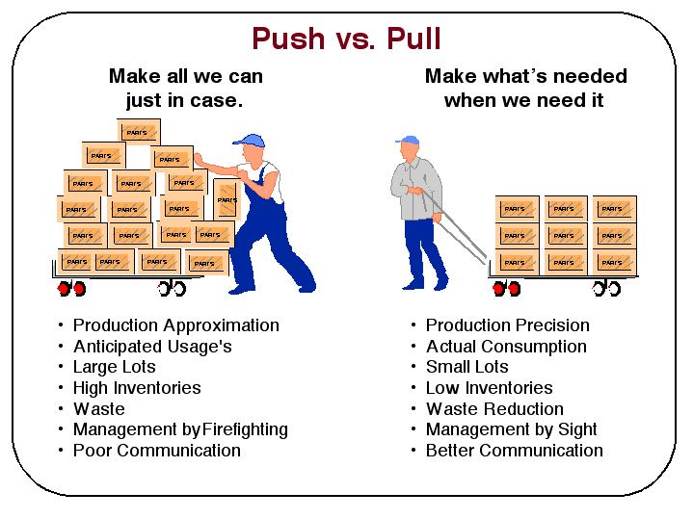

Slide 90
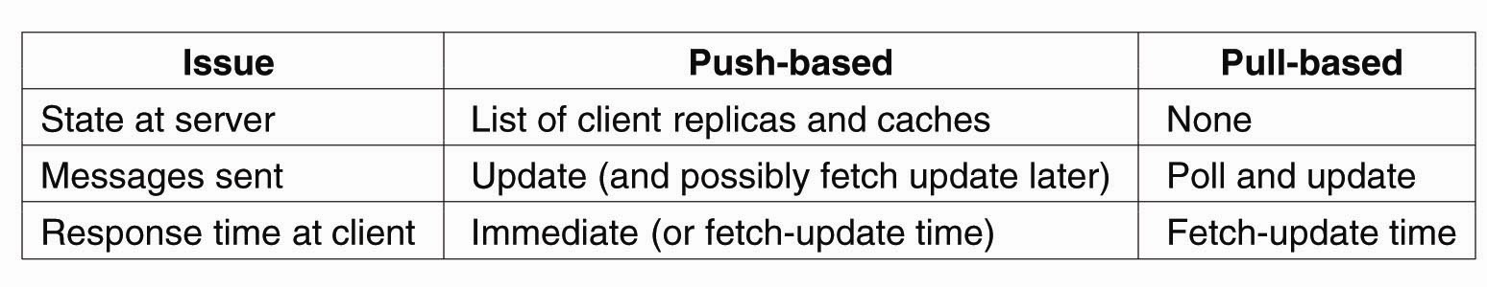
Comparison Between Push-Based and Pull-Based Protocols
In the case of multiple-client, single-server systems
These trade-offs have lead to a hybrid form of update propagation based on leases.
Stateful servers are often less fault tolerant
When updates are only invalidations

Slide 91

Lease (1)
A lease is a promise by the server that it will push updates to the client for a specified time
A convenient mechanism for dynamically switching between a push-based and pull-based strategy.
When a lease expires, the client is forced to poll the server for updates and pull in the modified data if necessary.
An alternative is that a client requests a new lease for pushing updates when the previous lease expires.

Slide 92
Lease (2)
Issue: Make lease expiration time dependent on system’s behavior (adaptive leases):
Age-based leases: An object that hasn’t changed for a long time, will not change in the near future, so provide a long-lasting lease
Renewal-frequency based leases: The more often a client requests a specific object, the longer the expiration time for that client (for that object) will be
State-based leases: The more loaded a server is, the shorter the expiration times become

Slide 93
Unicasting vs. Multicasting (1)
Unicast communication: when a server that is part of the data store sends its update to N other servers, it does so by sending N separate messages, one to each server.
With multicasting, the underlying network takes care of sending a message efficiently to multiple receivers.
duplicate
duplicate
creation/transmission
In many cases, it is cheaper to use available multicasting facilities.
Example: when all replicas are located in the same LAN and that hardware broadcasting is available.
R1
R1
duplicate
R2
R2
R3
R4
R3
R4
source duplication
in-network
duplication

Slide 94
Unicasting vs. Multicasting (2)
Multicasting + push-based approach
When the two are carefully integrated, a server that decides to push its updates to a number of other servers simply uses a single multicast group to send its updates.
Unicasting + pull-based approach
It is generally only a single client or server that requests its copy to be updated.

Slide 95
Unit 7 – Consistency & Replication: Outline
Introduction
Data-Centric Consistency Models
Client-Centric Consistency Models
Replica Management
Consistency Protocols
Summary

Slide 96
Consistency Protocols
So far, mainly concentrated on various consistency models and general design issues for consistency protocols.
Now concentrate on the actual implementation of consistency models by taking a look at several consistency protocols.
A consistency protocol describes an implementation of a specific consistency model.
Primary-based protocols
Replicated-write protocols
Cache-coherence protocols
Implementing client-centric consistency
Implementation about Data-centric models

Slide 97
Continuous Consistency
Bounding numerical deviations
Bounding staleness deviations
Bounding ordering deviations
Primary-based protocols
a.k.a. primary backup protocols
Replicated-write protocols
Similar solution
YU, H. and VAHDAT, A.: "Efficient Numerical Error Bounding for Replicated Network Services."

Slide 98
Bounding Ordering Deviations (1)
Ordering deviations in continuous consistency are caused by the fact that a replica server tentatively applies updates that have been submitted to it.
Result:
Each server will have a local queue of tentative writes for which the actual order still needs to be determined.
The ordering deviation is bounded by specifying the maximal length of the queue of tentative writes.
Notes:
quorum
[5kwC:rEm]
n.
法定人数, 选出的团体

Slide 99

Bounding Ordering Deviations (2)
When the length of this local queue of tentative writes > a specified maximal length, a server
will no longer accept any newly submitted writes,
but will instead attempt to commit tentative writes by negotiating the order with other servers.
We actually need to enforce a globally consistent ordering of tentative writes, often by primary-based or quorum-based protocols
Notes:
quorum
[5kwC:rEm]
n.
法定人数, 选出的团体
Until now, if a nature photographer wanted to arrange pictures of various butterflies systematically based on color or size to create an illustrated book, a lot of time was needed: The artist would have to arrange the individual pictures of the animals on the computer by hand to bring them into the requested order. Suitable software that would have been able to arrange pictures automatically based on certain characteristics did not exist. Researchers have now developed a method that makes it possible to arrange numerous pictures very fast.
Saarbrücken computer scientists have developed a system to arrange pictures into a consistent order. It requires no more than a small number of pre-sorted example pictures. The illustration shows different butterflies organized horizontally by color variations and vertically by size.

Slide 100
Primary-Based Protocols Remote-Write Protocols (1)
provide a straightforward implementation of sequential consistency
Evidently, all processes see all write operations in the same order, no matter which backup server they use to perform read operations.
primary-backup protocol: all write operations need to be forwarded to a fixed single server. Read operations can be carried out locally.
Notes:
In the case of sequential consistency, it turns out that primary-based protocols
prevail.
In these protocols, each data item x in the data store has an associated primary,
which is responsible for coordinating write operations on x. A distinction
can be made as to whether the primary is fixed at a remote server or if write operations
can be carried out locally after moving the primary to the process where the
write operation is initiated.
The simplest primary-based protocol that supports replication is the one in
which all write operations need to be forwarded to a fixed single server. Read operations
can be carried out locally. Such schemes are also known as primarybackup
protocols (Budhiraja et al., 1993). A primary-backup protocol works as
shown in the above Figure.
A potential performance problem with this scheme is that it may take a relatively
long time before the process that initiated the update is allowed to continue.
In effect, an update is implemented as a blocking operation.

Slide 101
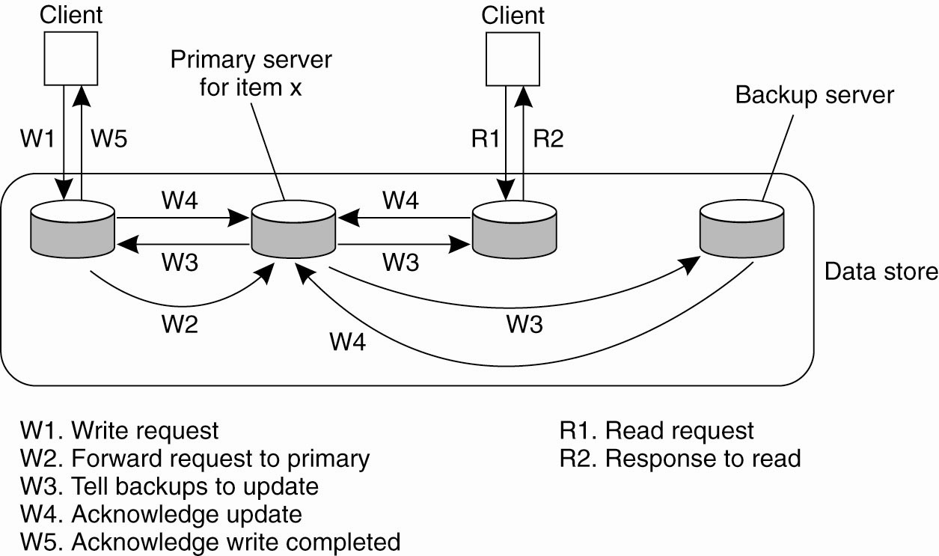
Primary-Based Protocols Remote-Write Protocols (2)
primary-backup protocol
When all backups have updated their local copy, the primary sends an acknowledgment (W5) back to the initial process.
An update is implemented as
a blocking operation → performance problem
Notes:
In the case of sequential consistency, it turns out that primary-based protocols
prevail.
In these protocols, each data item x in the data store has an associated primary,
which is responsible for coordinating write operations on x. A distinction
can be made as to whether the primary is fixed at a remote server or if write operations
can be carried out locally after moving the primary to the process where the
write operation is initiated.
The simplest primary-based protocol that supports replication is the one in
which all write operations need to be forwarded to a fixed single server. Read operations
can be carried out locally. Such schemes are also known as primary-backup
protocols (Budhiraja et al., 1993). A primary-backup protocol works as
shown in the above Figure.
A potential performance problem with this scheme is that it may take a relatively
long time before the process that initiated the update is allowed to continue.
In effect, an update is implemented as a blocking operation.

Slide 102
Primary-Based Protocols Local-Write Protocols (1)
The primary copy migrates between processes that wish to perform a write operation
Advantage:
write operations may speed up considerably.
multiple, successive write operations can be carried out locally, while reading processes can still access their local copy
Processes will always see the effects of their most recent write operation (cannot be guaranteed)
Such an improvement can be achieved only if a nonblocking protocol is followed by which updates are propagated to the replicas after the primary has finished with locally performing the updates.
Notes:
An alternative is to use a nonblocking approach. As soon as the primary has updated its local copy of
x, it returns an acknowledgment. After that, it tells the backup servers to perform
the update as well. The main problem with nonblocking primary-backup protocols has to do with
fault tolerance. In a blocking scheme, the client process knows for sure that the
update operation is backed up by several other servers. This is not the case with a
nonblocking solution. The advantage, of course, is that write operations may
speed up considerably.
Primary-backup protocols provide a straightforward implementation of sequential
consistency, as the primary can order all incoming writes in a globally
unique time order. Evidently, all processes see all write operations in the same
order, no matter which backup server they use to perform read operations. Also,
with blocking protocols, processes will always see the effects of their most recent
write operation (note that this cannot be guaranteed with a nonblocking protocol
without taking special measures).
The main advantage
of this approach is that multiple, successive write operations can be carried
out locally, while reading processes can still access their local copy. However,
such an improvement can be achieved only if a nonblocking protocol is followed
by which updates are propagated to the replicas after the primary has finished
with locally performing the updates.

Slide 103
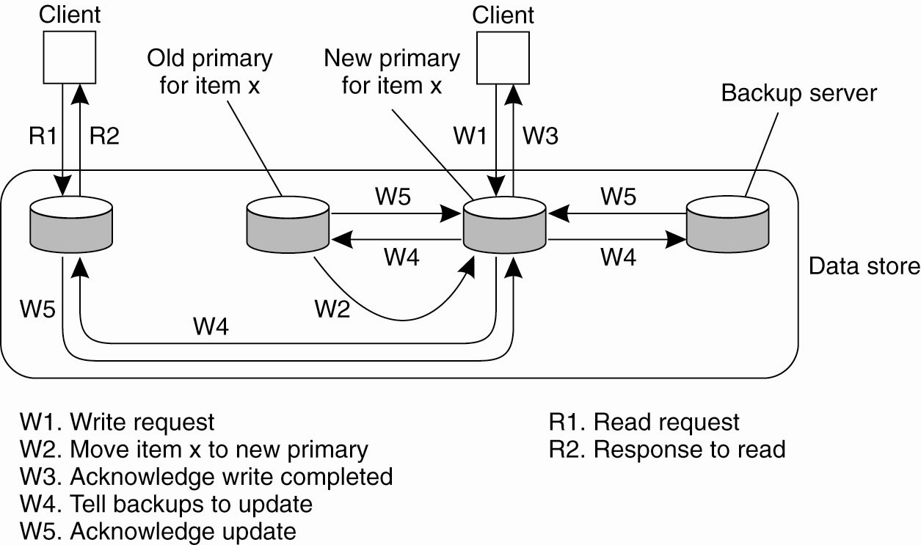
Primary-Based Protocols Local-Write Protocols (2)
Nonblocking local-write primary-based protocols can be applied to mobile computers and distributed file systems
The main problem with nonblocking primary-backup protocols has to do with fault tolerance.
Notes:
An alternative is to use a nonblocking approach. As soon as the primary has updated its local copy of
x, it returns an acknowledgment. After that, it tells the backup servers to perform
the update as well. The main problem with nonblocking primary-backup protocols has to do with
fault tolerance. In a blocking scheme, the client process knows for sure that the
update operation is backed up by several other servers. This is not the case with a
nonblocking solution. The advantage, of course, is that write operations may
speed up considerably.
Primary-backup protocols provide a straightforward implementation of sequential
consistency, as the primary can order all incoming writes in a globally
unique time order. Evidently, all processes see all write operations in the same
order, no matter which backup server they use to perform read operations. Also,
with blocking protocols, processes will always see the effects of their most recent
write operation (note that this cannot be guaranteed with a nonblocking protocol
without taking special measures).
The main advantage
of this approach is that multiple, successive write operations can be carried
out locally, while reading processes can still access their local copy. However,
such an improvement can be achieved only if a nonblocking protocol is followed
by which updates are propagated to the replicas after the primary has finished
with locally performing the updates.

Slide 104
Primary-Based Protocols Example of Local-Write Protocols
primary-backup protocol with local writes
Mobile computing in disconnected mode (ship all relevant files to user before disconnecting, and update later on).
Distributed file systems: there may be a fixed central server through which normally all write operations take place, as in the case of remote-write primary backup. However, the server temporarily allows one of the replicas to perform a series of local updates, as this may considerably speed up performance.

Slide 105
Replicated-Write Protocols
Write operations can be carried out at multiple replicas instead of only one, which is the case of primary-based replicas.
Active Replication (an operation is forwarded to all replicas)
Quorum-Based Protocols (based on majority voting)
Notes:
quorum
[5kwC:rEm]
n.
法定人数, 选出的团体

Slide 106
Active Replication
In active replication, each replica has an associated process that carries out update operations. In contrast to other protocols, the operation is sent to each replica.
Problem: Totally-ordered multicast mechanism is needed
Using Lamport's logical clocks
Scalability problem in large distributed systems
Alternatively, total ordering can be achieved using a central coordinator (a sequencer)
strongly resembles primary-based consistency protocols.
Note: using a sequencer does not solve the scalability problem.
Often using the combination
Notes:
In active replication, each replica has an associated process that carries out
update operations. In contrast to other protocols, updates are generally propagated
by means of the write operation that causes the update. In other words, the operation
is sent to each replica. However, it is also possible to send the update, as discussed
before.
One problem with active replication is that operations need to be carried out
in the same order everywhere. Consequently, what is needed is a totally-ordered
multicast mechanism. Such a multicast can be implemented using Lamport's logical
clocks, as discussed in the previous chapter. Unfortunately, this implementation
of multicasting does not scale well in large distributed systems. As an alternative,
total ordering can be achieved using a central coordinator, also called a sequencer.
One approach is to first forward each operation to the sequencer, which
assigns it

Slide 107
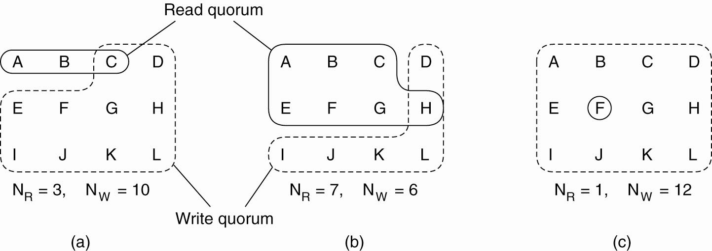

Quorum-Based Protocols
Majority voting: to require clients to request and acquire the permission of multiple servers before either reading or writing a replicated data item.
Distinguish read quorum (N_{R}) and write quorum (N_{W} ):
Two Constraints:
N_{R} + N_{W} > N (prevents read-write conflicts)
N_{W} > N/2 (prevents write-write conflicts)
ROWA:
Read One, Write all

Slide 108


Quorum-Based Protocols Example
If there are five servers and a client determines that three of them have version 8, it is impossible that the other two have version 9.
After all, any successful update from version 8 to version 9 requires getting three servers to agree to it, not just two.

Slide 109
Summary
There are primarily two reasons for replicating data: improving the reliability of a distributed system and improving performance.
Replication introduces a consistency problem
Solution: relax consistency somewhat.
Different consistency models exist.
For continuous consistency, the goal is set to bounds to numerical deviation between replicas, staleness deviation, and deviations in the ordering of operations.
As opposed to these data-centric models, researchers in the field of distributed databases for mobile users have defined a number of client-centric consistency models.
Consistency protocols describe specific implementations of consistency models.

Slide 110
Seminar Topics
Web hosting services
Adaptive Leases
Byzantine fault tolerance
Compare different algorithms for mutual exclusion
Gossip-based coordination (Refer to the textbook)
Distributed event matching (Refer to the textbook)
Elections in wireless environment (Refer to the textbook)
Elections in large-scale systems (Refer to the textbook)

